Slide 1



James A. Petts
The Institute of Cancer Research London

Slide 2

What is XNAT?

Slide 3

Data Archiving:
Easily connect to multiple types of DICOM application entities (AEs), including scanners, PACS systems, and PACS routers.
XNAT Desktop Client – Upload data from your hard drive to XNAT.
ZIP Uploader – Upload zipped data to the archive through the web interface.
Upload via REST API.

Slide 4

Managed Access:
Projects -> Subjects -> Sessions -> Scans.
Configurable Read/Write/Edit on each database element.
Can optionally make part/all of your projects public, so guest users can read data.
Example case:
Sarah is the PI of a project and may upload/delete any data.
John is a Radiologist who can only view most of the data in the project, but whom may write image annotations to the database using the viewer.
Dan is a radiographer who may only upload new scans.

Slide 5

Automated Analysis Pipelines:
The XNAT automation system allows one to hook into events such as upload/delete/transfer and run processes automatically.
Launch custom Docker containers to perform analysis at scale either locally, or on a provider like AWS/Azure.

Slide 6
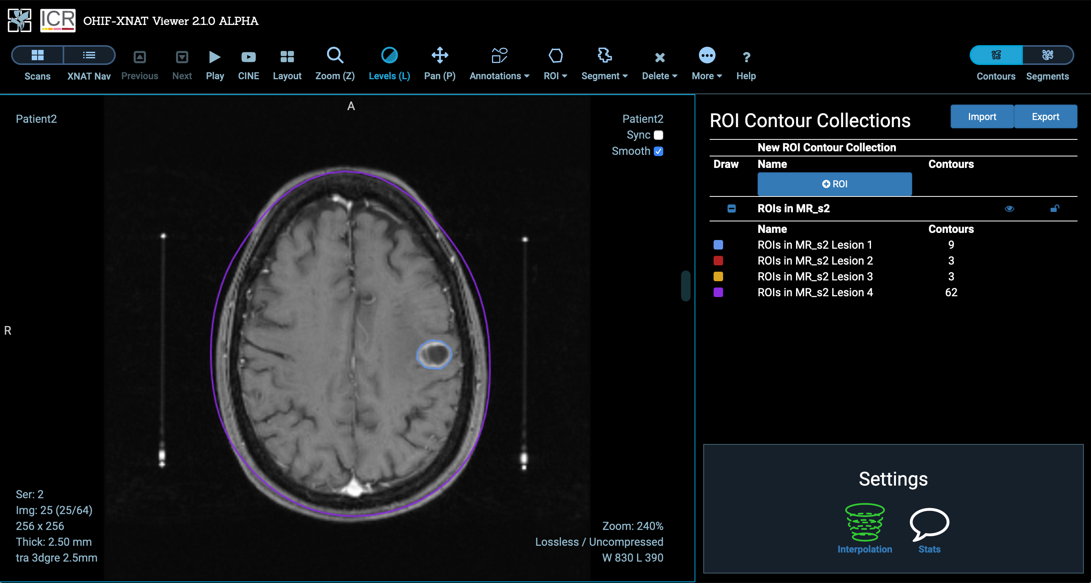
Review and Annotate Images:

Slide 7
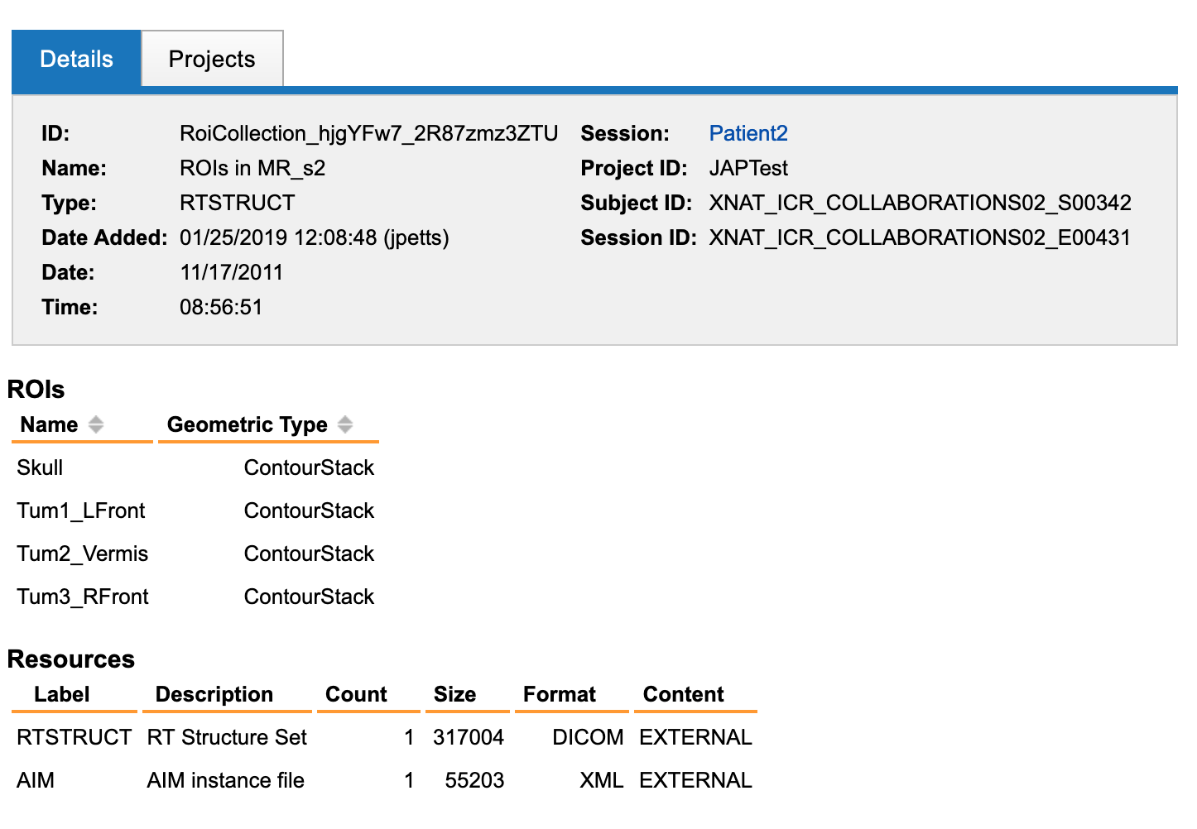
Review and Annotate Images:

Slide 8

Plugin Framework:
Custom Datatypes:
If you want to store custom data (e.g. patient biosample collections), you can simply write a java plugin that defines the XSD Schema for that.
The datatype will then be automatically indexable and searchable in the PostgreSQL database.
Custom Functionality:
Custom UI.
Custom server side processes/automated pipelines.
Custom web-apps with the authorization taken care of for you (e.g. the OHIF Viewer).

Slide 9

XNAT as a backend:
XNAT exposes all its data IO through a robust and simple RESTful API.
You can build standalone applications that pull/post data to/from XNAT.
We have a project named XNAT-Scaffold born last week, which is an electron app that takes care of all the authentication boilerplate for you, so you can quickly get started building an app that talks to one or more XNAT instances simultaneously.
Pyxnat can be also be used to easily authenticate and interface with XNAT using Python.

Slide 10
Thank You!

